Slide 1


Power BI Licensing Guide
Kyle Akepanidtaworn
Global Cloud Solution Architect (Data Platform & AI)
GSMO Digital Transformation Partnerships Team
koakepan@microsoft.com

Slide 2
Meet me
Kyle Akepanidtaworn
Global Cloud Solution Architect, Microsoft
40+ professional certifications across Microsoft, IBM, Tableau, INSEAD
Coach for Knowledge Mining and Azure Cognitive Search
Coach for Modern Data Warehousing on Azure
Azure for SAP Workloads
MCSA: BI Reporting Certified 2020
Microsoft-INSEAD AI Business School
Certified Data Analyst, Data Scientist, Data Engineer, and AI Engineer
Tableau Data Steward, Tableau Data Scientist, Tableau Developer
IBM Data Science Methodologies
Email: koakepan@micrsoft.com
LinkedIn: https://www.linkedin.com/in/korkridakepan/
Kyle Akepanidtaworn, a global cloud solution architect with the mission to helping customers and partners with Digital Transformation, Business Intelligence, Azure, Open Source, and Data Intelligence & Analytics etc. I am a trusted advisor to top Azure customers and help empower them to achieve more.
Specialties: BI + AI, data warehousing, data science, big data, Hadoop, cloud, master data management, machine learning, solution architecture, ETL, data modeling, data migration, dashboarding.

Slide 3
Power BI Licensing
Power BI Pro
Power BI Premium Per User (PPU)
Licensed by users.
Modern, self-service analytics to visualize data with live dashboards and reports and share insights across your organization.
Power BI Pro is included in Microsoft 365 E5.
Available to buy now with a credit card
Licensed by users.
Accelerate access to insights with advanced AI, unlock self-service data prep for big data, and simplify data management and access at enterprise scale.
Includes all the features available with Power BI Pro.
Available to buy now with a credit card.
User-based
Power BI Premium
Power BI Embedded
Capacity-based
Licensed by consumption/capacity.
An add-on to Power BI Pro for projects requiring heightened performance and the ability to publish reports and dashboards to consumers.
Accelerate access to insights with advanced AI, unlock self-service data prep for big data, and simplify data management and access at enterprise scale—without per-user licenses for content consumers.
Licensed by consumption/capacity.
Designed for an ISV & developer adding analytics & visuals into applications built & distributed without requiring per user licensing.
Still requires Power BI Pro license for authentication.
Notes:
The EPM that nominates the engagement for Azure Migration Assistance gathers info and completes a one-pager for the engagement such as the one found here.
The Account team raises a request via Unified Action Tracker (UAT) and assigns to a distribution list for Azure Migration Assistance.
Decision needed: who should be on the distro list?
Once the UAT ticket has been created and assigned to the distro, the people on the distro will see an email notification. I will primarily be responsible for monitoring the UAT issues coming in along with any help from Lone as a backup if needed.
We then tag each request with Azure Migration Assistance so we can easily separate these from other Scrum requests.
Decision needed: confirm we should use Azure Migration Assistance as the tag.
The request can then be reassigned to the owner that will be assigned to help unblock based on decision in this forum.
A view in MSXi Dashboard can be created based on the tag which we can use to review the status or send email status updates using this view.

Slide 4
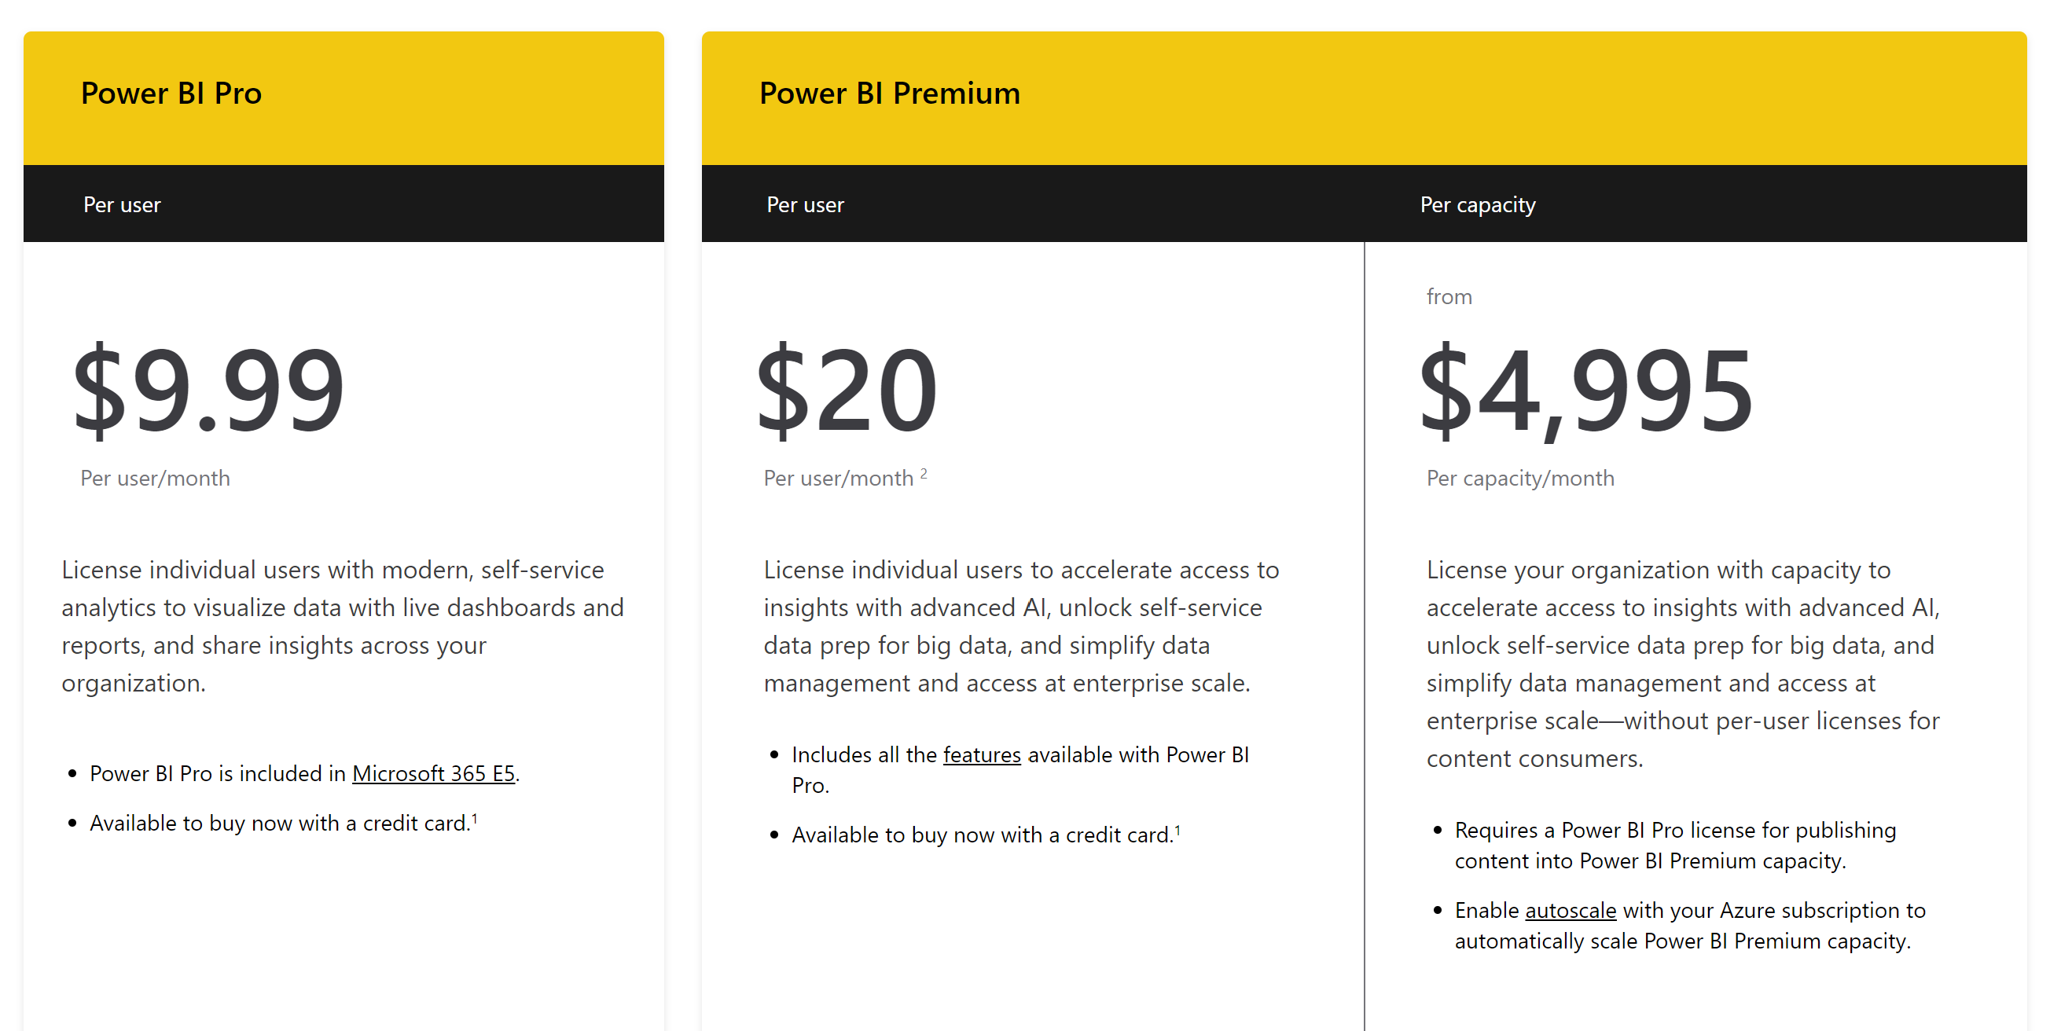

Slide 5
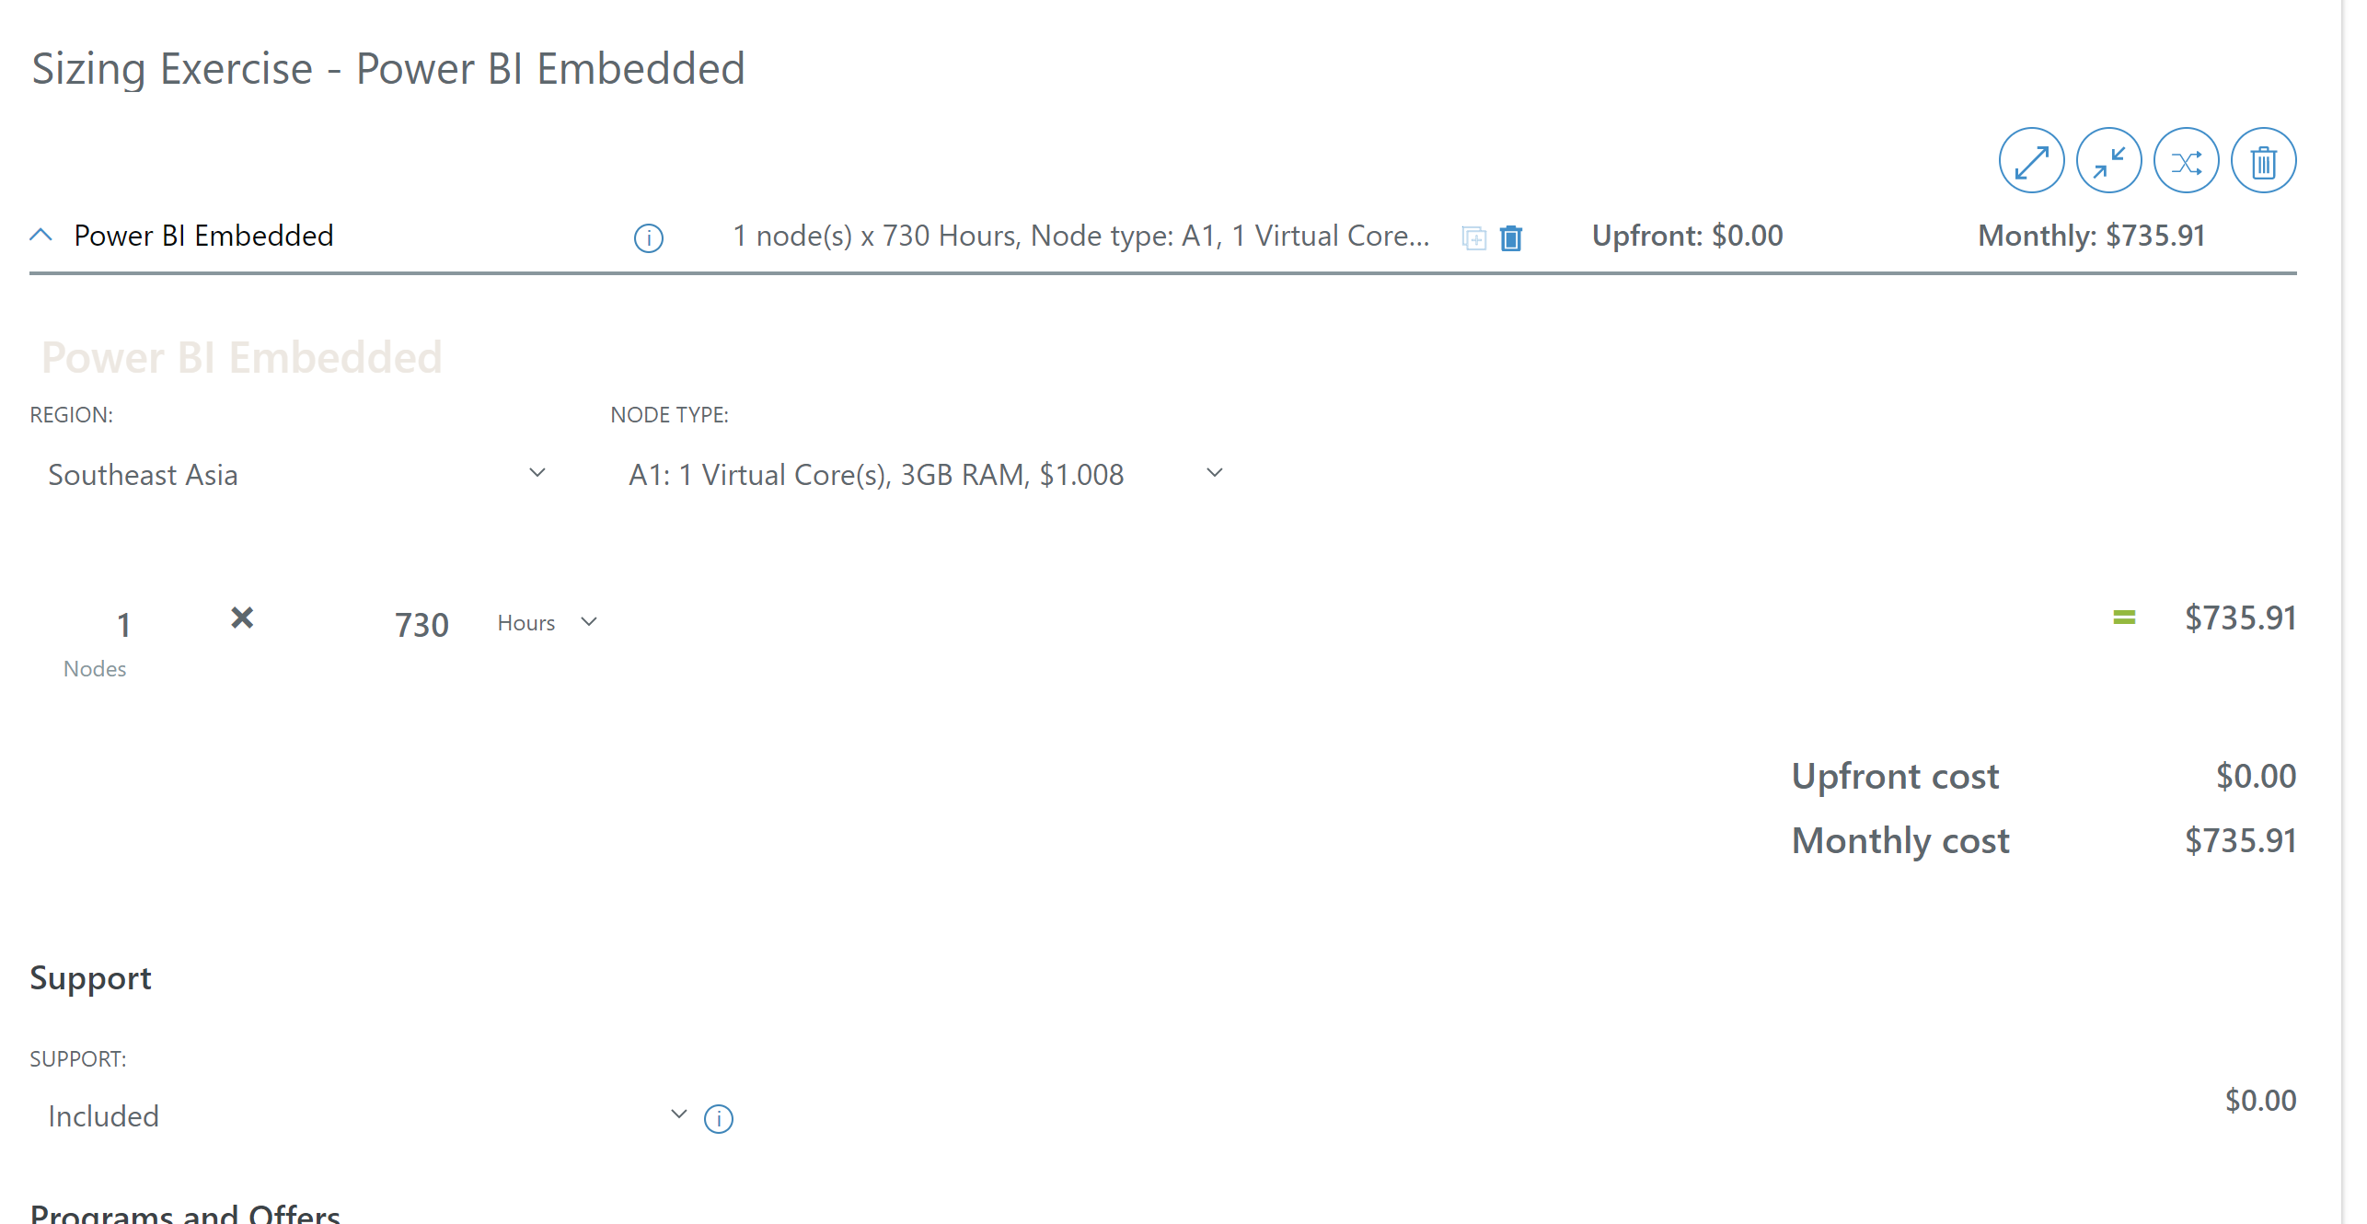
Power BI Embedded Pricing Calculator
Pricing Calculator | Microsoft Azure
Pricing varies by
selected cores (VMs)

Slide 6
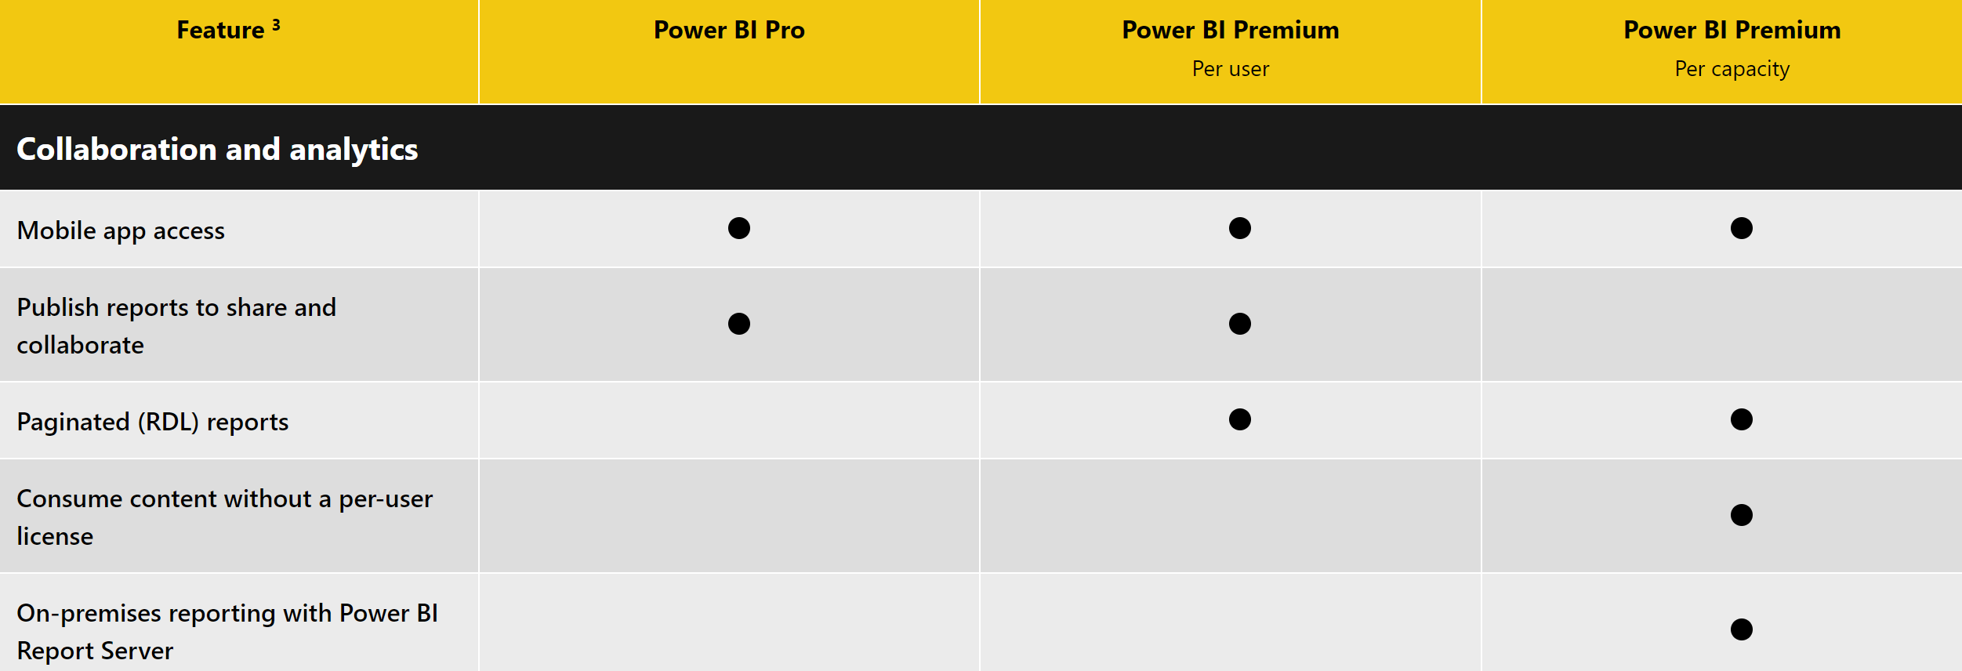
Power BI Capability Matrix For Different Licensing Options

Slide 7
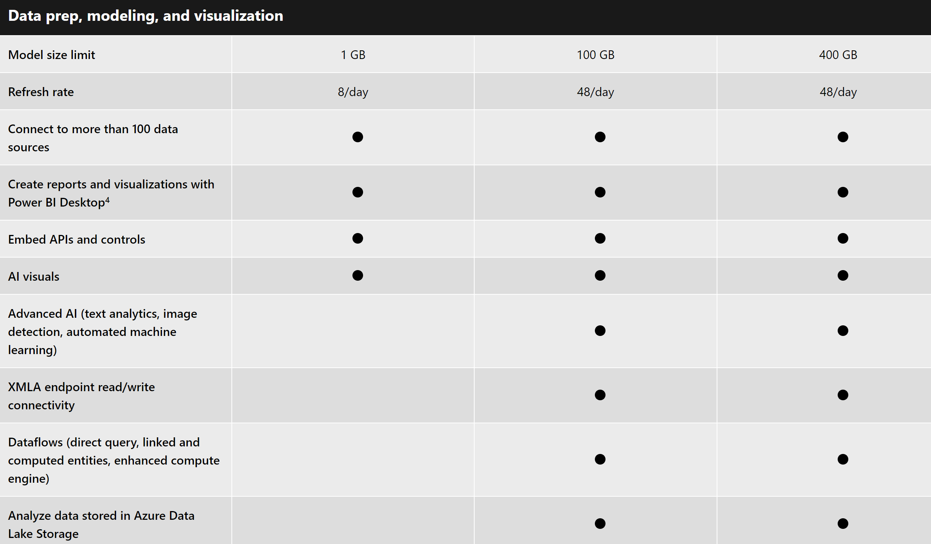
Power BI Capability Matrix For Different Licensing Options

Slide 8
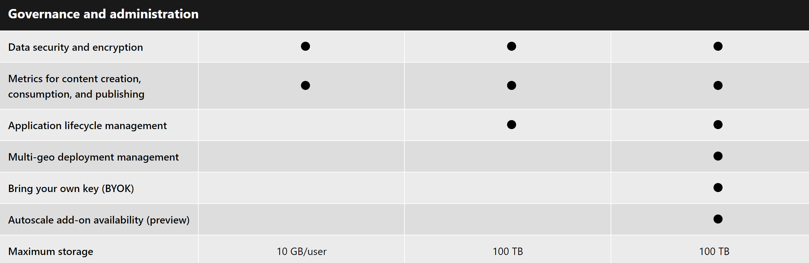
Power BI Capability Matrix For Different Licensing Options

Slide 9
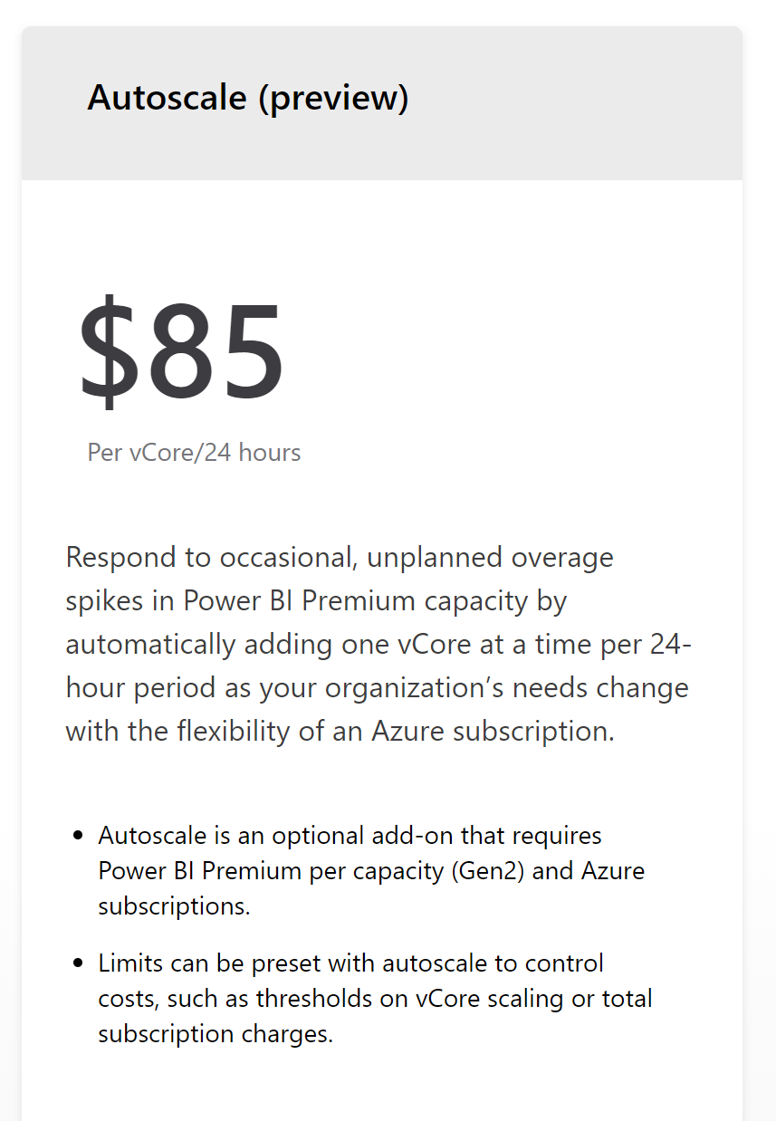
Power BI Capability Add-ons
Autoscale - Respond to occasional, unplanned overage spikes in Power BI Premium capacity by automatically adding one vCore at a time per 24-hour period as your organization’s needs change with the flexibility of an Azure subscription.
Custom Visuals - Visualize data your way, with our rich library of fully customizable, open-source data visualization tools. Power BI Custom Visuals – Data Visualization Tools | Power BI (microsoft.com)

Slide 10
Power BI Tooling
Power BI Desktop
Dax Studio
SSMS
Licensed by users.
Free to use; however, sharing reports and publishing to cloud require Power BI Pro subscription.
Quick, easy-to-use self-service analytics for users requiring collaboration, dashboard sharing, ad hoc analysis, and report publishing.
Use in tandem with Power BI Service (cloud-based hosting)
Licensed by users.
Free to use.
A client tool for executing DAX queries against various data sources.
DAX Studio will scan the local machine for any running instances of Power BI Desktop or SSDT Integrated Workspaces.
Licensed by users.
Free to use.
An integrated environment for managing any SQL infrastructure, from SQL Server to Azure SQL Database.
Tools to configure, monitor, and administer instances of SQL Server and databases.
Power BI Desktop for Report Server
Power BI Report Builder
SSDT
Licensed by users.
Free to use.
Quick, easy-to-use self-service analytics for users requiring collaboration, dashboard sharing, ad hoc analysis, and report publishing.
Use in tandem with Power BI Report Server (on-premise hosting)
Licensed by users.
Free to use.
A tool for authoring paginated reports.
Use in tandem with Power BI Service or Power BI Report Server.
Licensed by users.
Free to use.
A modern development tool for building SQL Server relational databases, Azure SQL Databases, Analysis Services (AS) data models, Integration Services (IS) packages, and Reporting Services (RS) reports.
Notes:
The EPM that nominates the engagement for Azure Migration Assistance gathers info and completes a one-pager for the engagement such as the one found here.
The Account team raises a request via Unified Action Tracker (UAT) and assigns to a distribution list for Azure Migration Assistance.
Decision needed: who should be on the distro list?
Once the UAT ticket has been created and assigned to the distro, the people on the distro will see an email notification. I will primarily be responsible for monitoring the UAT issues coming in along with any help from Lone as a backup if needed.
We then tag each request with Azure Migration Assistance so we can easily separate these from other Scrum requests.
Decision needed: confirm we should use Azure Migration Assistance as the tag.
The request can then be reassigned to the owner that will be assigned to help unblock based on decision in this forum.
A view in MSXi Dashboard can be created based on the tag which we can use to review the status or send email status updates using this view.

Slide 11
Power BI 2021
Tools
Power BI Desktop, Power BI Desktop for Report Server
Power BI Report Builder, SSMS, SSDT, Dax Studio,
Enterprise reporting
Paginated Reports
Self-Service
Data Exploration
Power BI Reports
Enterprise Semantic Models
Power BI Datasets
Governance & ALM
AI
Data Prep for Big Data
Power BI Dataflows

Slide 12



Power BI Report Hosting Options
Recommended
SQL Server Reporting Services
Power BI Report Server
Power BI Service
Power BI Embedded
Deployment
On-premises
On-premises
Cloud
Cloud
Power BI reports
Real-time dashboards
Content packs
Q&A
Quick Insight
Paginated reports
Mobile reports
Lifecycle
Fixed lifestyle policy
Modern lifestyle policy
Fully managed service
APIs
Notes:
Details on mobile BI (SSRS Datazen still supported etc.)
Discussion of features of Power BI Service that aren’t available in Power BI Report Server
Modern and Fixed policies
https://support.microsoft.com/en-us/help/4014109/announcing-modern-and-fixed-policies

